Slide 1
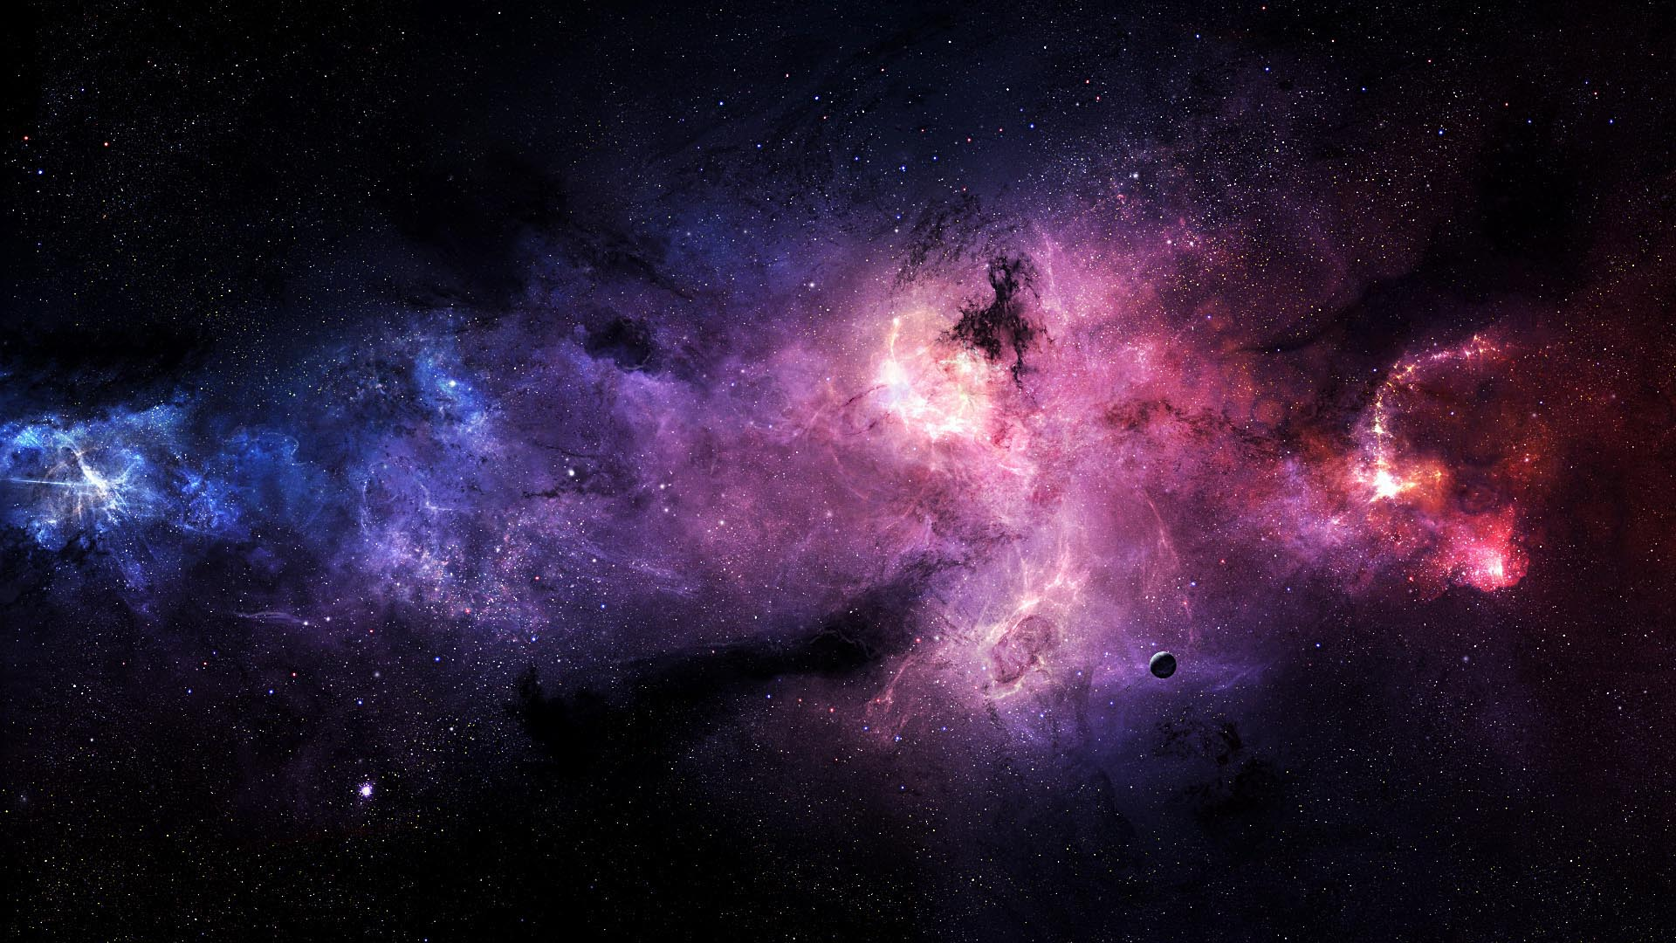
Visualizing 1 billion stars

Slide 2
team

Slide 3
Benjamin Neckam
Nicole Cherches
Alexander Gelb
Axinya Tokareva

Slide 4
agenda

Slide 5
1 Introduction
2 Lo-Fi Prototype
3 Hi-Fi Prototype
4 Conclusion

Slide 6
Introduction

Slide 7
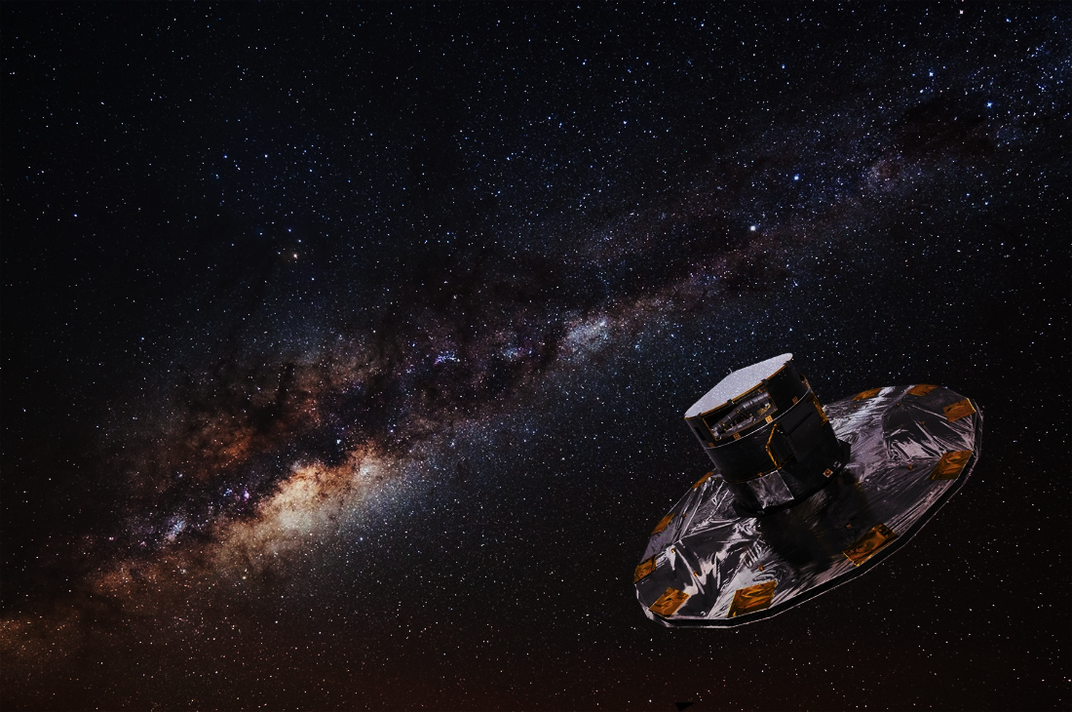
Topic Description
M1
ESA Mission
Gaia
First contact with data
million stars

Slide 8

Dataset
M1
positions
characteristics
distances
parallaxes
values of motions
magnitudes

Slide 9
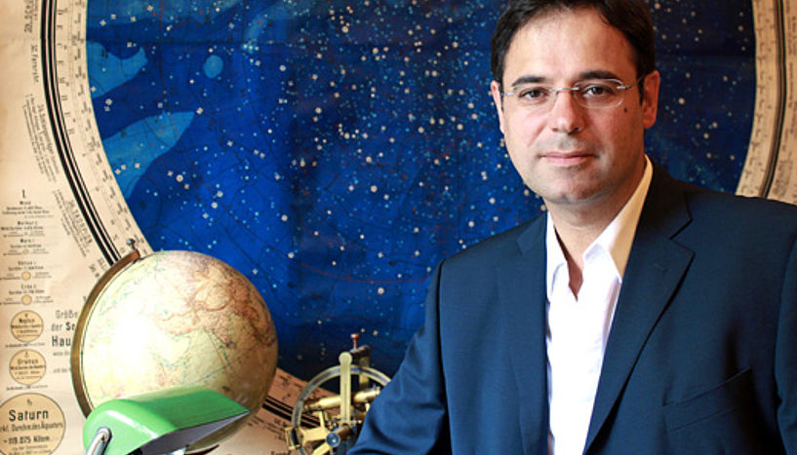
Fictitious User
M1
João Alves

Slide 10
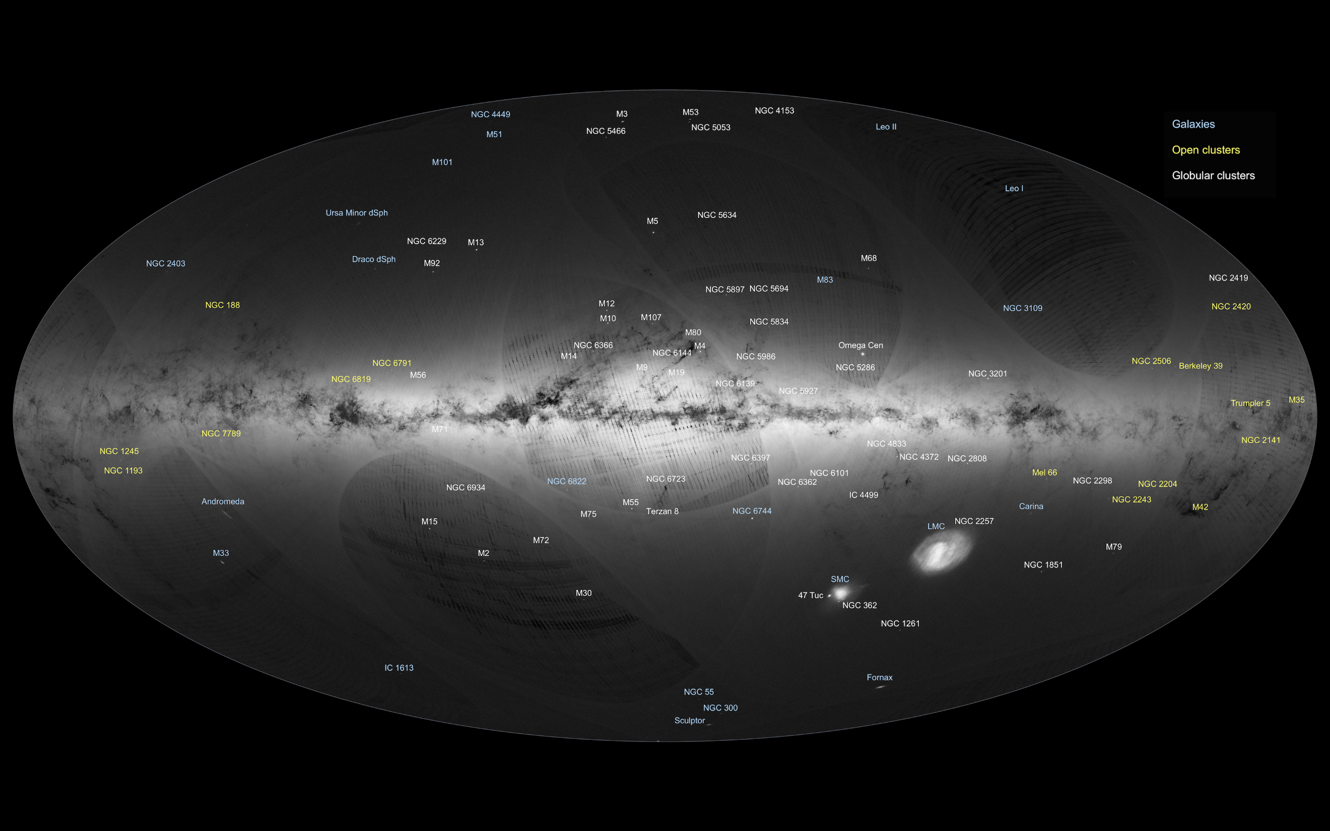
Gaia's first sky map [2]

Slide 11
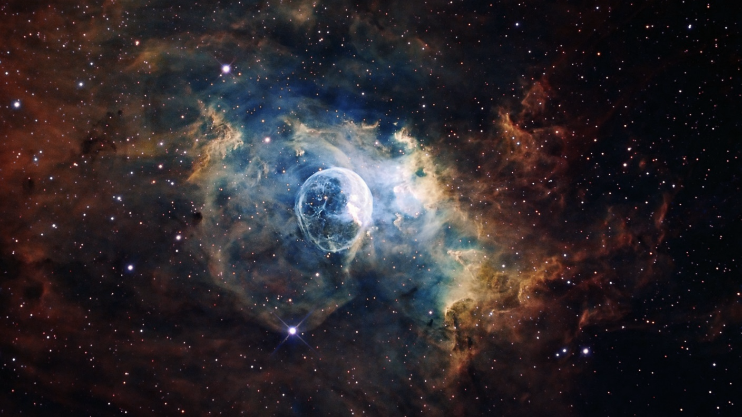
Lo-Fi Prototype
M2

Slide 12

M2

Slide 13
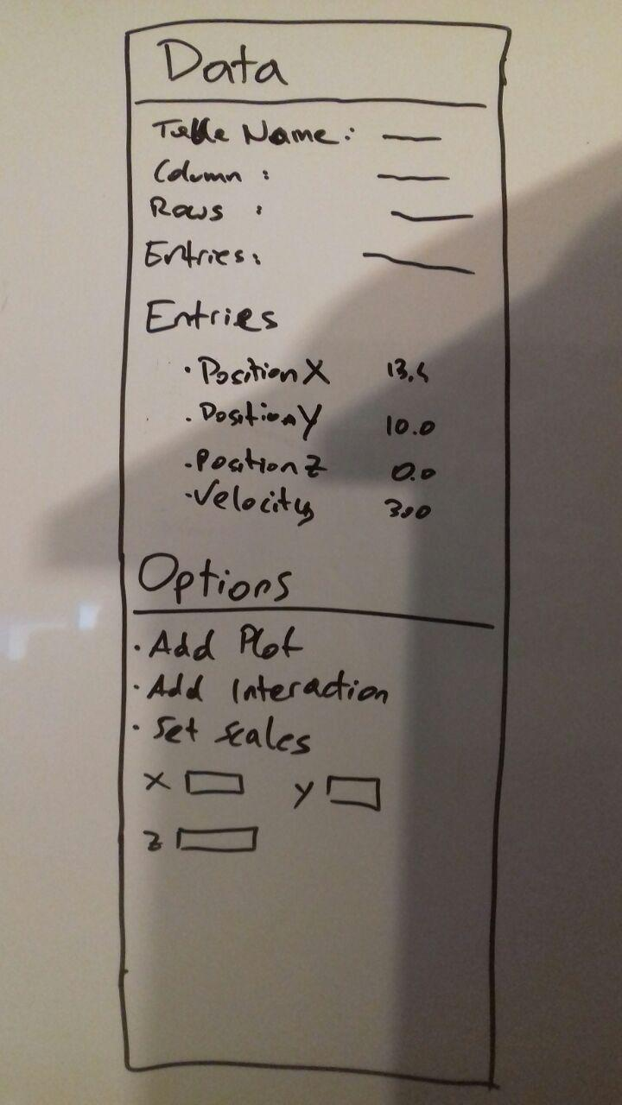
M2

Slide 14
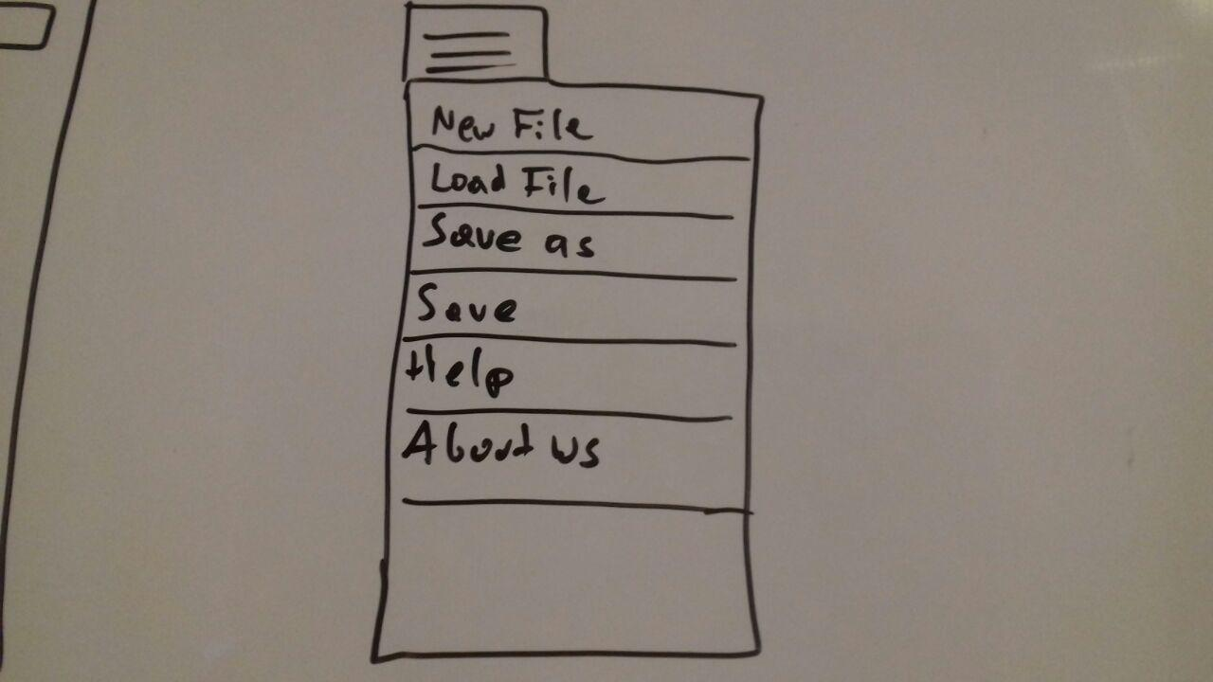
M2

Slide 15
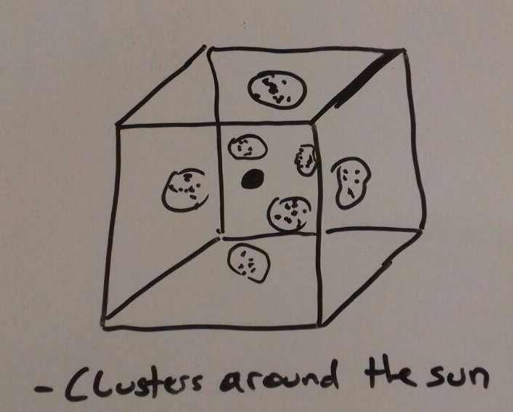
M2

Slide 16
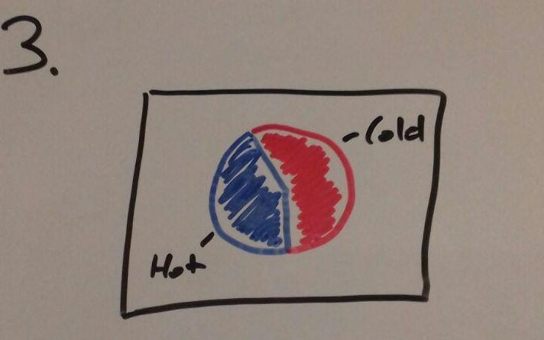
M2

Slide 17
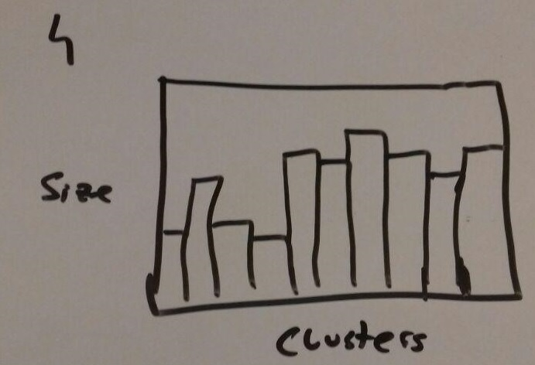
M2

Slide 18
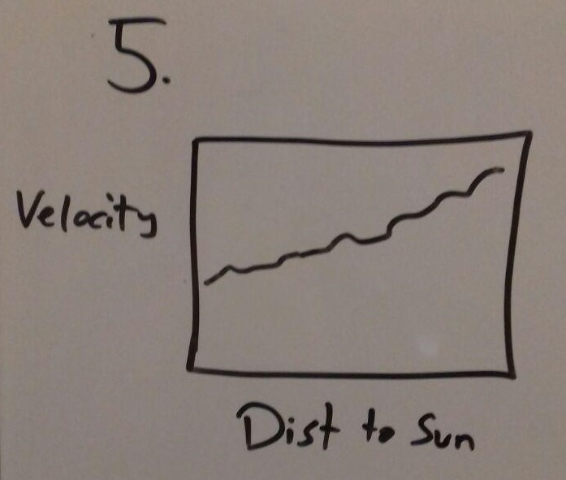
M2

Slide 19
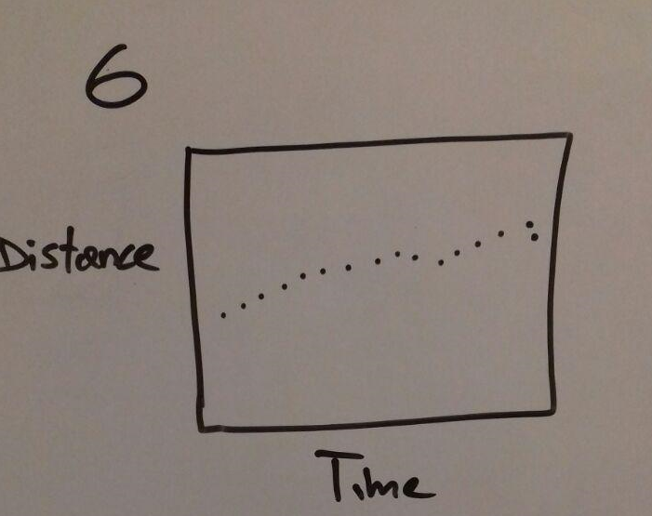
M2

Slide 20
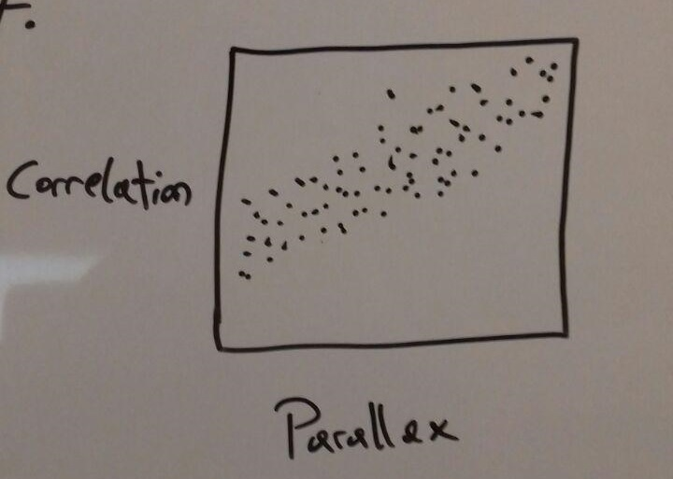
M2

Slide 21
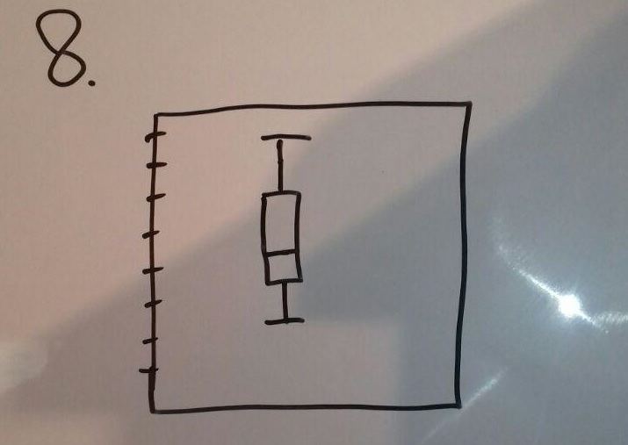
M2

Slide 22
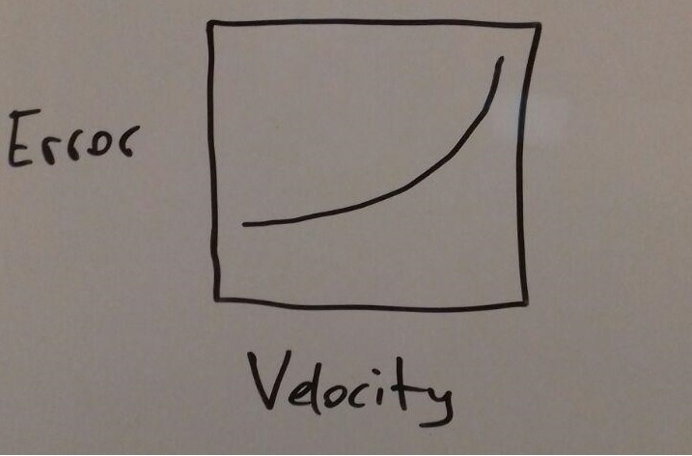
M2

Slide 23
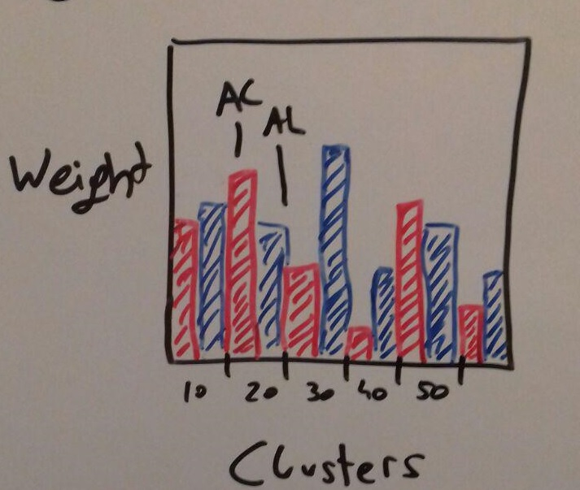
M2

Slide 24
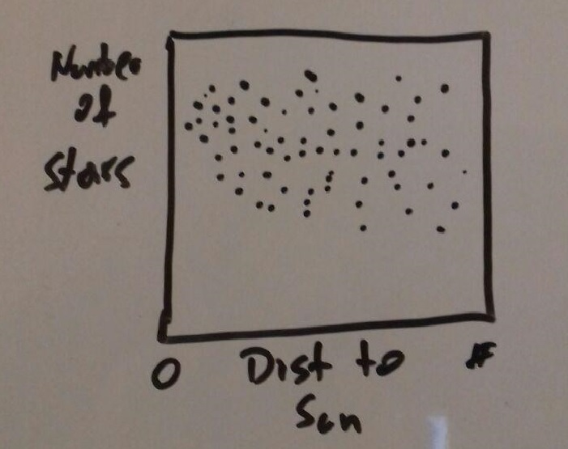
M2

Slide 25
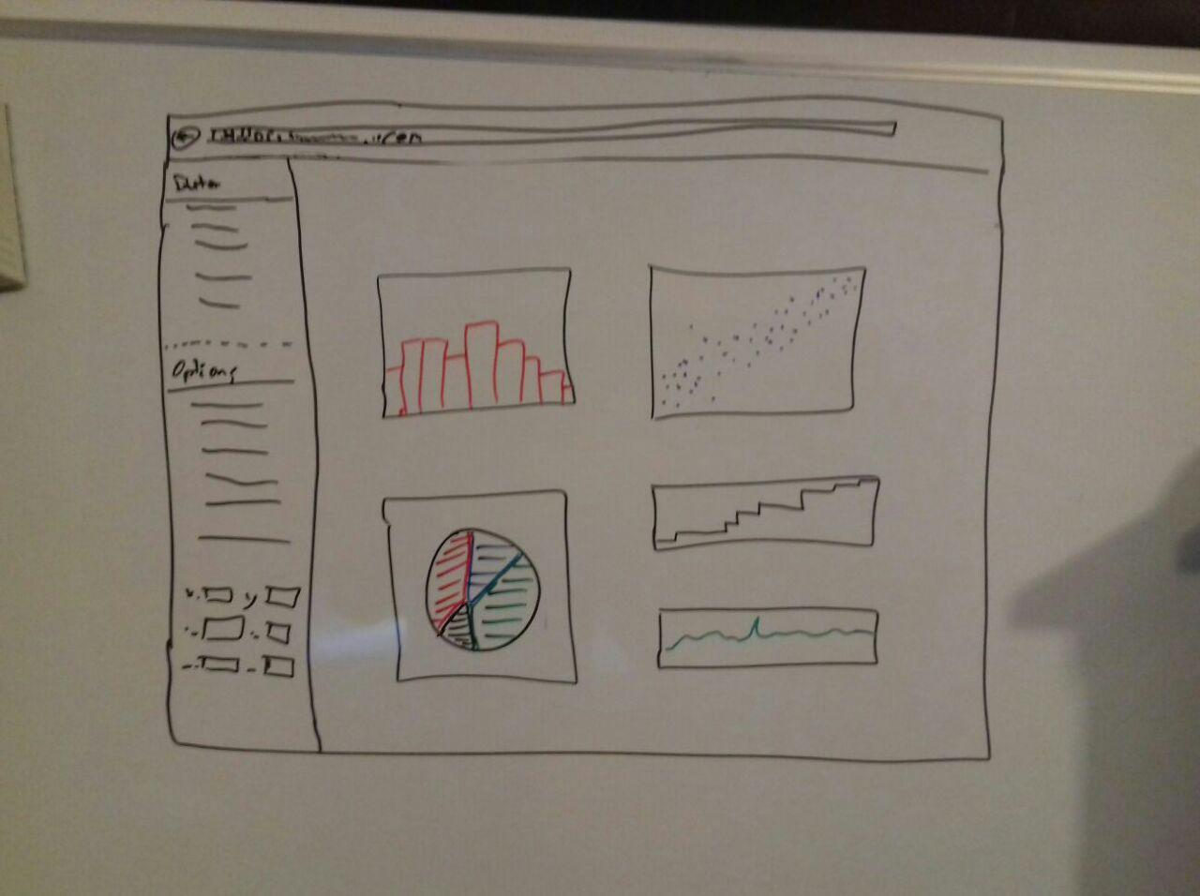
M2

Slide 26
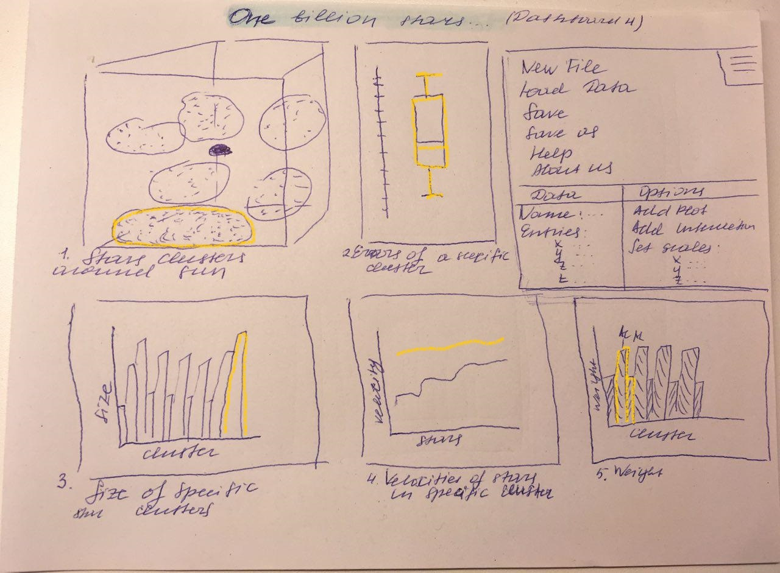
M2

Slide 27
TASKS
2 discovery of new objects
1 appearance and development
of our Galaxy with the help of
a survey of stars
3 detailed map
M2/3
5 Overview of the data
4 existence of black holes

Slide 28
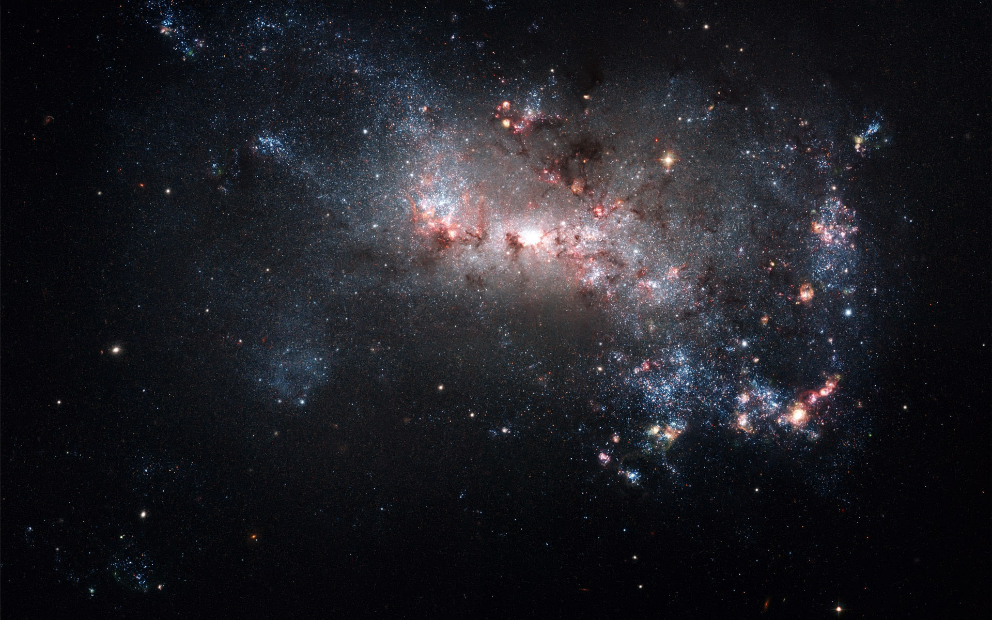
Hi-Fi Prototype
M3

Slide 29
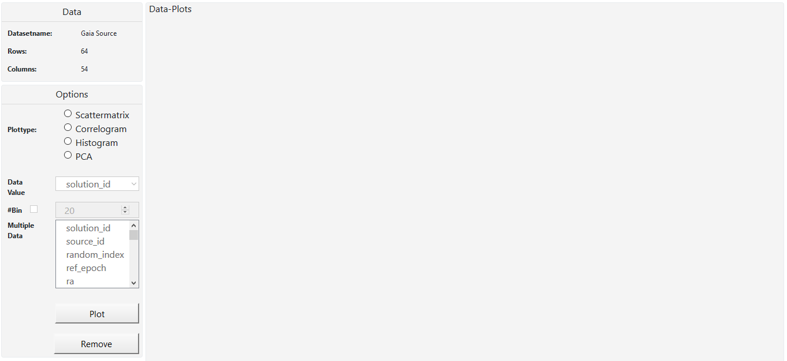
M3

Slide 30
//TODO scattermatrix image1
M3

Slide 31
//TODO scattermatrix image2
M3

Slide 32
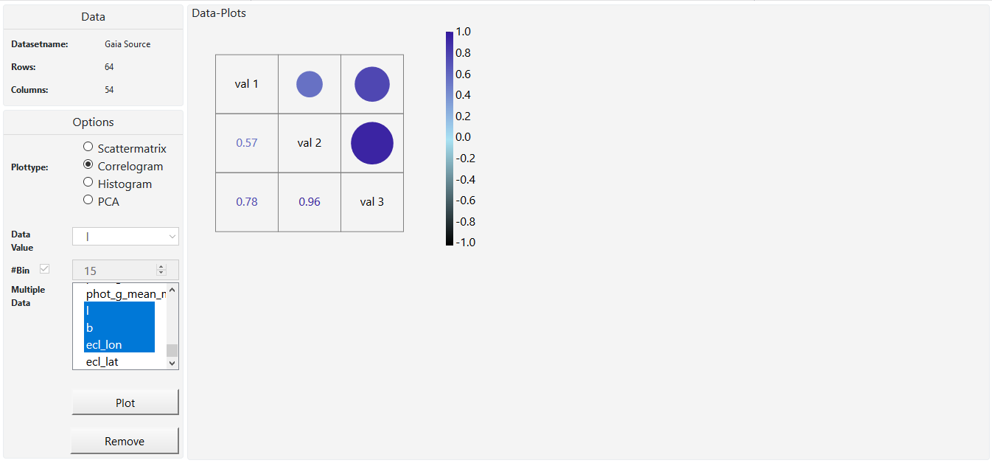
M3

Slide 33
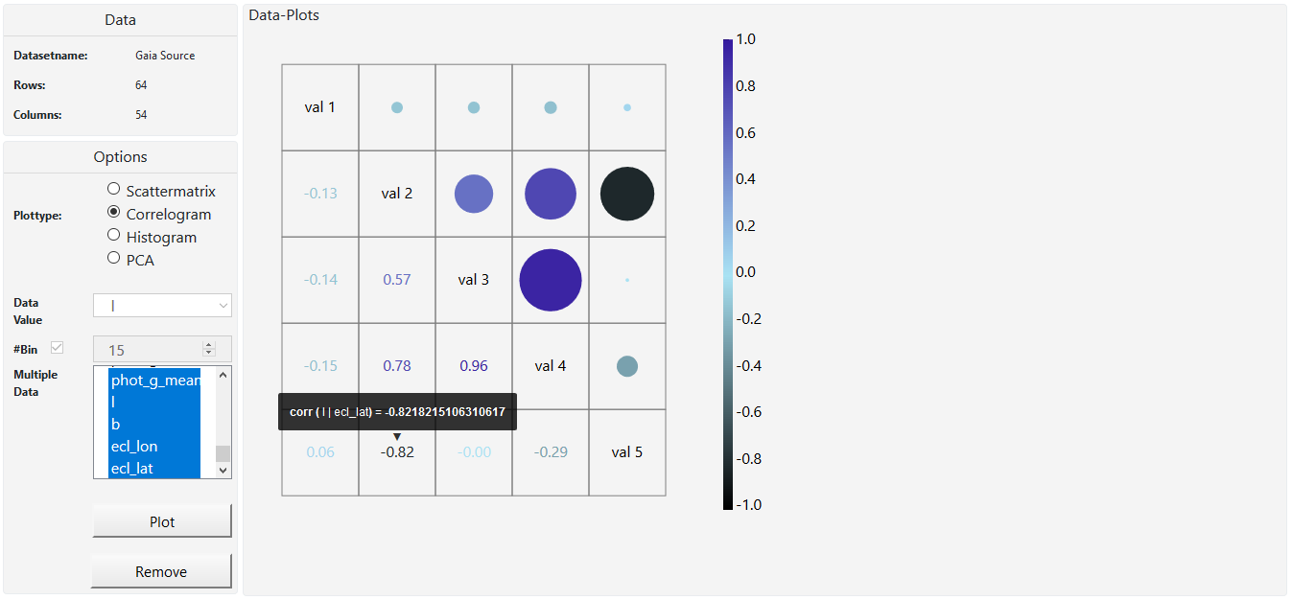
M3

Slide 34
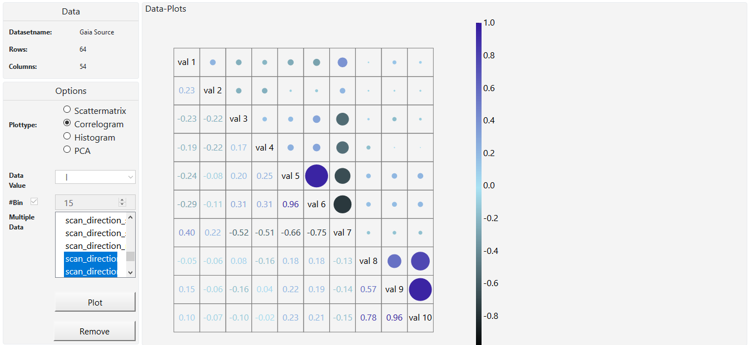
M3

Slide 35
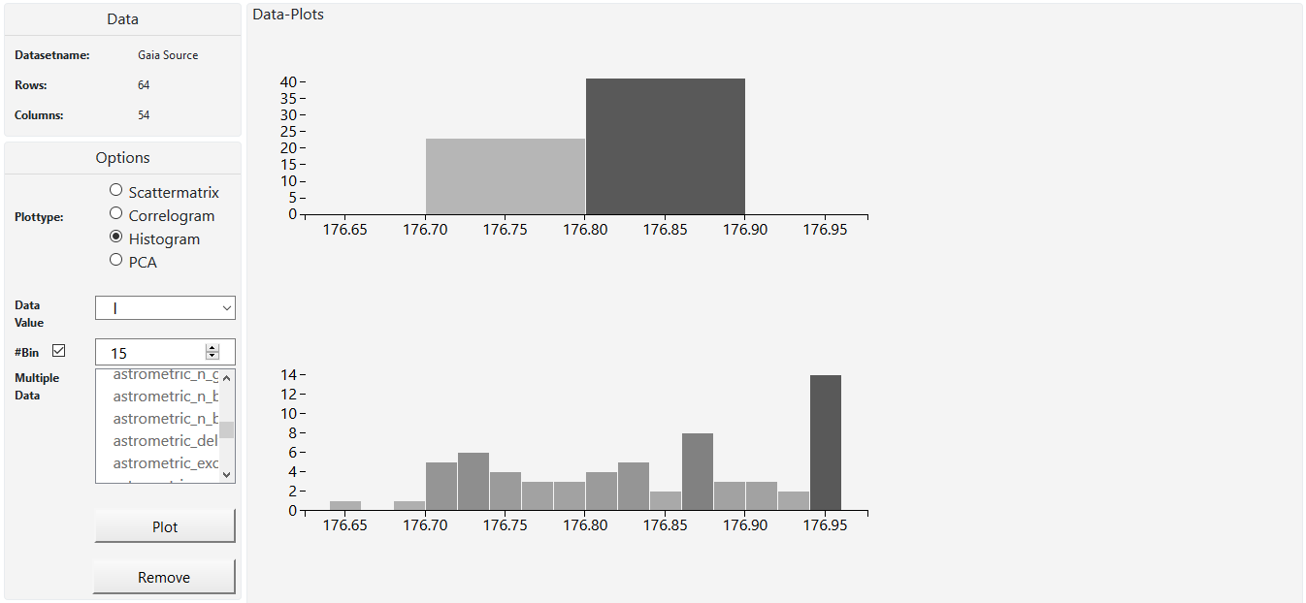
M3

Slide 36
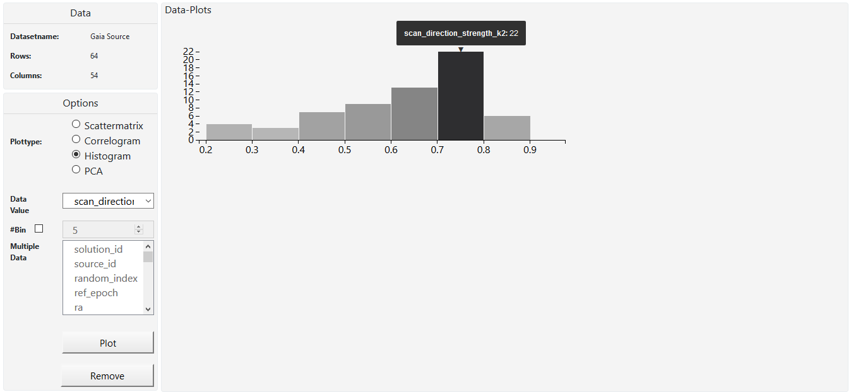
M3

Slide 37
//TODO pca image1
M3

Slide 38
//TODO pca image2
M3

Slide 39
Techniques
M3
1 tooltips
2 correlation over
multiple var
3 filter
4 brushing & linking

Slide 40
literatur

Slide 41
1 http://wwwlab.cs.univie.ac.at/~a1368965/vis17/
2 http://sci.esa.int/gaia/58275-data-release-1
3 Google images

Slide 42
vielen dank

Slide 43
fragen?

